Slide 1
1:1
For Success
Student Initial Training for
Technology Integration
Implementing a district-wide 1:1 initiative, putting technology in the hands of our learners today, so they succeed as citizens, workers, and leaders in a digital world.
1:1 Technology Integration
Notes:
Dear Teachers:
This PowerPoint presentation was created to assist you in training your students on 1:1 Technology Integration. Each slide contain “Teacher Notes” to guide your conversations with your students. This presentation is meant to serve as an overview and introduction only. Video tutorials on GAFE have been added so that your students can visually see the exciting things they’ll be able to do with their Chromebook. Use the video tutorials and GAFE challenges as you see fit for your students Happy Training!
TEACHER’S NOTES:
Our district has embarked on an exciting journey of 1:1 Technology Integration. This means every 5th through 8th grade student is receiving a laptop-like device called a Chromebook and a Google Apps for Education Account. This is wonderful opportunity for you to have a powerful piece of technology in your hands that will change the way you learn. I’m going to provide you with training that will help you understand why and how we are going to use this technology. You will also learn about the major responsibilities that come with this privilege.

Slide 2
GOALS for TODAY
District’s Vision for integration of technology
Model for training and support, and knowing YOUR role
What technology integration is and what components are necessary
Chromebook overview
GAFE overview
1:1 Technology Integration
Notes:
TEACHER’S NOTES:
Here are our goals for training today:
Our district has a Vision for 1:1. I will share that Vision with you and help you to understand how we’ll work toward that Vision together
A lot of work and many people have made this initiative possible. It’s important that I share with you how training and support will be provided and your role as students.
You will receive a an overview of technology integration and the components necessary to achieve it. Now that we have these devices, we must use them responsibly and effectively.
The Chromebook overview will include the basic features of a Chromebook, safety, and care. We will also look at the Carrier 30 which is the Cart where devices will be housed, locked, and charged.
The GAFE overview will give you basic information on the Google Apps for Education. We’ll practice using some Apps today!

Slide 3
OVERVIEW
OVERARCHING GOAL:
East Baton Rouge Parish School System will equip, educate, and empower every educator and learner to actively engage in technology-rich learning environments that prepare all students to succeed as citizens, workers, and leaders in a digital world.
It is imperative that we, as a district, shift our philosophy and adapt our approach to meet the needs of a modern teacher and a modern learner in an increasingly digitally-driven and interconnected world.
1:1 Technology Integration
Notes:
TEACHER’S NOTES:
Ask a student to read the Overarching Goal.
Our district has made an enormous commitment and employees are working diligently every day to ensure that we are able to engage in a technology-rich environment.

Slide 4
VISION & MISSION
Vision
District staff, educators, and students at all levels integrate technology in meaningful and diverse ways that promote effective communication and collaboration - advancing teaching and learning in every classroom to positively impact outcomes for our students.
Mission
All members of our dynamic team, instructional and technology support, will work together towards a shared goal - supporting every student in developing the skills and knowledge needed to succeed in a progressive, technology-reliant, global society through a dynamic technology-integrated learning environment that is reliable, effective, ethical, and transformative.
1:1 Technology Integration
Notes:
TEACHER’S NOTES:
Ask a student to read the Vision and another to read the Mission.
The 1:1 Technology Integration Vision calls for advancing teaching and learning and ensuring positive academic outcomes. That means the work we do must be meaningful and has to have a positive impact. That will be the standard in guiding our use of the devices. The Mission of 1:1 Technology Integration tells us, as a district, how we will get there.

Slide 5
TECHNOLOGY INTEGRATION GOALS
1:1 Technology Integration
Notes:
TEACHER’S NOTES:
Now that we’ve looked at the Vision and Mission, let’s review the goals that are going to get us there.

Slide 6
DISTRICT GOALS
1 | LEADERSHIP Create a culture for innovation and change. Embed a responsibility among education leaders at all levels to cultivate technology-rich learning environments and set district-wide and school-level visions for technology in learning.
2 | LEARNING Increase outcomes for students through technology Through meaningful integration of technology, all learners will have engaging and empowering (learning) experiences that enable them to exit school fully prepared to achieve success in a wide-range of pursuits.
3 | TEACHING Effective utilization and integration of technology Educators will be supported by technology that connects them to people, data, content, resources, expertise, and learning experiences that will empower and inspire them to provide more effective teaching for all learners.
4 | ASSESSMENT Measure for learning At every level, our district will leverage the power of technology to measure what matters most, and use valid and reliable assessment data to inform decision making and improve learning.
5 | INFRASTRUCTURE Enabling access, safety, and security Our district will work together across departments to maintain a robust and comprehensive technology infrastructure that ensures all students and educators will have access when and where they need it.
Notes:
TEACHER’S NOTES:
Ask 5 volunteers to read each goal. Briefly discuss each goal.

Slide 7
HANDBOOK
East Baton Rouge Parish School System 1:1 Chromebook
Technology Handbook
Administrative Guidelines
1:1
For Success
Notes:
TEACHER’S NOTES:
A 1:1 Chromebook Technology Integration Handbook has been created to inform you and your parents of what to expect related to the use of Chromebooks. We will review this document together and I'll answer any questions you may have.

Slide 8
TRAINING & SUPPORT
1:1 Technology Integration
Notes:
TEACHER’S NOTES:
Training and support is being provided at every level to ensure success.

Slide 9
MODEL for TRAINING & SUPPORT
1:1 Technology Integration Team
Executive Directors & Instructional Specialists
Principals & Site Liaisons
Teachers
Students
Strategic Plan for 1:1 Technology Integration
Notes:
TEACHER’S NOTES:
This is the model for training and support. The 1:1 Technology Integration Team has trained our Executive Directors and Instructional Specialists. Executive Directors and Instructional Specialists will support the training of Principals and Site Liaisons. Principals and Site Liaisons will redeliver training to teachers who will then be responsible for training students. This is a model that will be repeated throughout the year as more and more training is delivered. Today you are receiving an overview, but I will provide additional training as we move forward.

Slide 10
TECHNOLOGY INTEGRATION: The Components
Digital Citizenship
CommonSense Media Scope & Sequence
Digital
Literacy Skills
LDOE Digital Literacy Guide Technology Readiness
Standards Based Instruction
TECHNOLOGY INTEGRATION
CONTENT
PEDAGOGY
Academic Content
Louisiana Student Standards, Curriculum Resources
Assignment/ Activity/ Task
(DOK)
GAFE, digital resources
(SAMR)
1:1 Technology Integration
Notes:
TEACHER’S NOTES:
True Technology Integration requires several components. We’re not going just open Chromebooks without a plan. It’s not enough to just have technology present in the room. We will start with our Standards and Academic Content, as always, and integrate Digital Citizenship, Digital Literacy, and the use of Google Apss for Education.

Slide 11
DIGITAL LITERACY & DIGITAL CITIZENSHIP
1:1 Technology Integration
Notes:
TEACHER’S NOTES:
First, let’s discuss Digital Literacy and Digital Citizenship.

Slide 12
DIGITAL LITERACY
The ability to use technology to find, evaluate, create, and communicate information. Along with a working knowledge of computer software and hardware, students will benefit from an understanding of a wide range of applications becoming so mainstream, it is vital to be fluent in their use when entering the workforce.
Building Digital Literacy -LDOE
1:1 Technology Integration
Notes:
TEACHER’S NOTES:
This definition of Digital Literacy comes from the Louisiana Department of Education. It summarizes what you should be able to do. These are the digital skills you'll need far beyond graduation.

Slide 13
2016 Technology Readiness Skills
Basic Computer Operations
Word Processing
Spreadsheets and Visual Data Tools
Mathematical Applications
Presentation and Multimedia Tools
Acceptable Use, Online Safety and Plagiarism
Keyboarding
1:1 Technology Integration
Notes:
TEACHER’S NOTES:
Here's a snapshot of the Technology Readiness Skills we'll learn and practice.

Slide 14
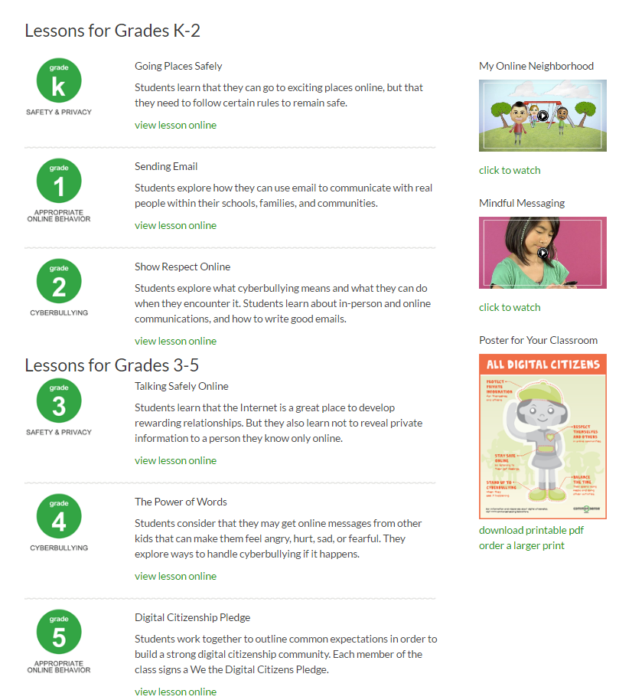
DIGITAL CITIZENSHIP – STUDENT LESSONS
https://www.commonsensemedia.org/educators/erate-teachers
1:1 Technology Integration
Notes:
TEACHER’S NOTES:
There’s an organization called Common Sense Media and they have a digital citizenship curriculum. During the year, we will explore this curriculum to learn about important things such as Safety and Privacy, Appropriate Online Behavior, and Cyberbullying. How many of you are aware that when you are on the internet, you leave a digital footprint? Colleges and Universities, employers, and others look to check your activity online. They use the information they find to make decisions admissions and hiring decisions. Additionally, everything to do on your Chromebook is monitored by the district's Department of Technology Support so please act responsibly
Click the link to preview the lessons for students.

Slide 15
CHROMEBOOK
1:1 Technology Integration
Notes:
TEACHER’S NOTES:
Next, we’ll look at what the Chromebook can do and some key features. After this portion of the training , you'll have the opportunity to come and get a Chromebook. We’ll explore Google Chrome and some Google Apps for Education.

Slide 16
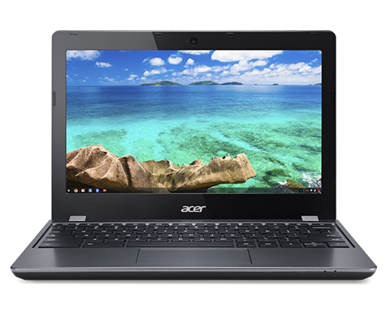
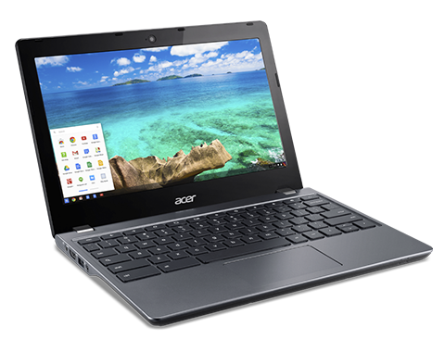
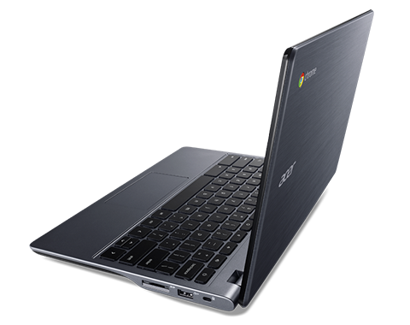
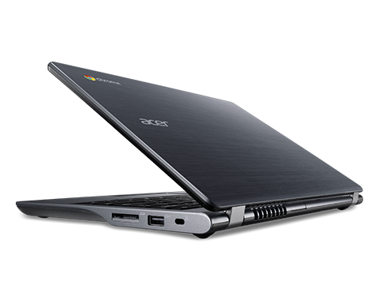
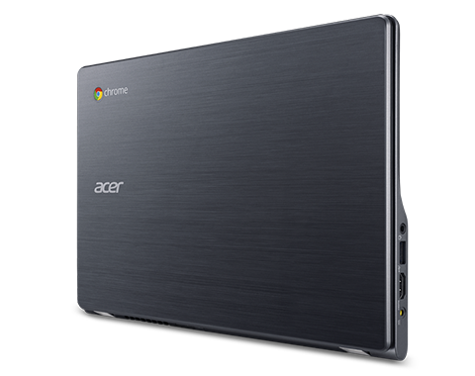
The Acer c740 Chromebook
1:1 Technology Integration
Notes:
TEACHER’S NOTES:
You’ll notice the Chromebook is lighter and more durable than the average laptop because it was made for educational use.

Slide 17
What is a Chromebook?
1:1 Technology Integration
Notes:
TEACHER’S NOTES:
This 2 minute video will provide a look into the power of a Chromebook.

Slide 18
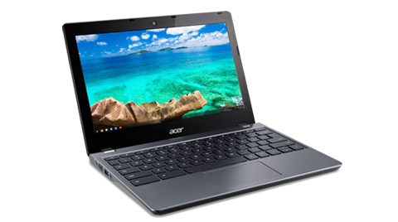
What is a Chromebook?
Acer Chromebook 11 C740
Features:
Long battery life (8-9 hours when fully charged)
Fast wireless internet
Starts in under 8 seconds
Thousands of apps
Built in virus protection
Backs up all files in the cloud
More durable than many laptops
1:1 Technology Integration
Notes:
TEACHER’S NOTES:
Go over the features with students.

Slide 19
What is a Chromebook?
Acer Chromebook 11 C740
Features:
Settings and resources follow the student
Many Accessibility features
Centrally managed and monitored by DTS
1:1 Technology Integration
Notes:
TEACHER’S NOTES:
Go over the features with students.

Slide 20
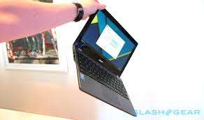
Basic Chromebook Care
Do
Use two hands when handling Chromebooks
Keep Chromebooks flat on the desk or table
Keep the device keyboard clear of pencils, pens, etc.
Don’t
Pick up Chromebooks by the screen (a leading cause of cracked screens)
Write on the Chromebook with Sharpie (silver)
Allow students to tamper with the property control tag or DTS tags
1:1 Technology Integration
Notes:
TEACHER’S NOTES:
Take this time to set a standard with respect to classroom management and procedures.
These are some very important do’s and don’ts. Chromebook are durable, but will not withstand abuse.

Slide 21
Basic Chromebook Care
Do
Keep food and drinks away from the Chromebook
Fully charge devices each day
Keep your Chromebook username and password super safe!
Don’t
Use any liquids or chemicals to clean the device – Use a microfiber cloth when needed
Use anything hard (like a pencil) to touch the screen or type
Forget that all internet activity is tracked by the DTS – be a great digital citizen!
1:1 Technology Integration
Notes:
TEACHER’S NOTES:
Take this time to set a standard with respect to management and procedures. Continue to read the do’s and don’ts.

Slide 22
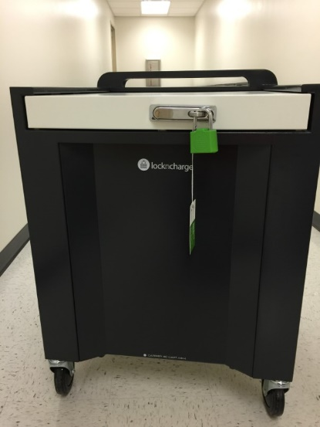
The Chromebook Cart
Lock n Charge Cart
Size is favorable for classroom use
Keys vs. Combination Carts
Sliding Top Secures the Cart
1:1 Technology Integration
Notes:
TEACHER’S NOTES:
The Carrier 30 Cart provides storage and charging for the Chromebooks.

Slide 23
The Chromebook Cart
Lock n Charge Cart
Size is favorable for classroom use
Keys vs. Combination Carts
Sliding Top Secures the Cart
1:1 Technology Integration
Notes:
TEACHER’S NOTES:
Here’s another look at the cart. Be sure not to store anything on the Sliding Top! It cannot bare much weight.

Slide 24
The Chromebook Cart - Charging
Exterior charging status
Eco-Safe Charging
1:1 Technology Integration
Notes:
TEACHER’S NOTES:
Again, this would be an excellent to talk about your expectations. You should practice the classroom procedure for handling the devices before moving on to GAFE training.
This video shows a student assigned to plugging in and charging Chromebooks. Our classroom procedure will be...

Slide 25
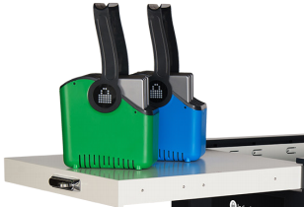
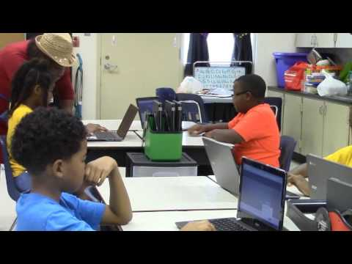
The Chromebook Cart
Google Classroom Glen Oaks Park Elementary
Mrs. Davis’ 2nd Grade Classroom
1:1 Technology Integration
Notes:
TEACHER’S NOTES:
This is a video of Mrs. Davis’ 2nd Grade Classroom managing and using their Chromebooks. What's most important to note is that these are young students seamlessly engaging with their device. I have the same expectations for our classroom. Let’s watch the video and then we’ll practice our own procedure.

Slide 26
Google Apps for Education
1:1 Technology Integration
Notes:
TEACHER’S NOTES:
Now that we’ve looked at the Chromebook, let’s shift gears and talk about Google Apps for Education.

Slide 27
Google Chrome
1:1 Technology Integration
Notes:
TEACHER’S NOTES:
The web browser and operating system for the Chromebook is Google Chrome. Google Chrome is a browser that combines a minimal design with sophisticated technology to make the web faster, safer, and easier.

Slide 28
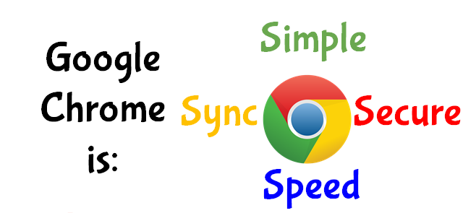
Google Chrome
1:1 Technology Integration
Notes:
TEACHER’S NOTES:
Chrome is simple, secure, fast, and syncs automatically. Your work will follow your Google Account, not a particular device. Therefore, no matter where you are or what device you’re working on, you work is always synced, saved, and secure.

Slide 29
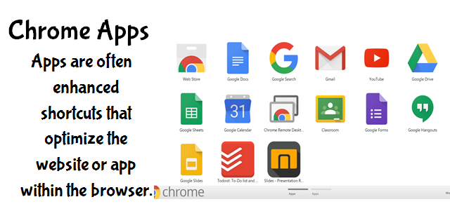
GAFE
1:1 Technology Integration
Notes:
TEACHER’S NOTES:
Read the slide.
These Apps operate in Chrome. Some of them may be familiar to you. Next, I’ll provide you with an overview of some of the Apps available.

Slide 30
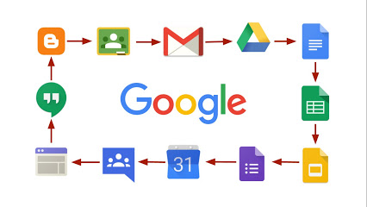
GAFE
1:1 Technology Integration
Notes:
TEACHER’S NOTES:
Find out how many of these apps your students are familiar with.
There are many, many apps available through google to enhance lessons and use as tools. We will briefly discuss a few of those apps today.

Slide 31
GAFE
1:1 Technology Integration
Notes:
TEACHER’S NOTES:
A major benefit of the Google Apps for Education Account is the unlimited storage capacity of Google Drive and access to Google Classroom, which is only available with a GAFE Account.

Slide 32
GAFE
1:1 Technology Integration
Notes:
TEACHER’S NOTES:
To begin to familiarize yourself with the some of the more frequently used Google Apps, take a look at the Google Apps counterparts to the Microsoft Office programs.

Slide 33
Google Drive
Stores files with limitless storage
Accessible from any device using google drive
Files and folders can be shared for viewing, editing, and commenting
1:1 Technology Integration
Notes:
TEACHER’S NOTES:
Google Drive is similar to the hard drive on your computer. However, with Google Apps, all your work is automatically saved to drive. Within Drive, you also have the ability to share your files and folder by a website link or with specific individuals via EBR Google Account email addresses. Sharing can be controlled with setting like: view only, suggest only, and full editing.

Slide 34
Google Docs
Online word processor
Allows collaboration
Can be downloaded as a word document
Can upload and convert word documents to Docs
1:1 Technology Integration
Notes:
TEACHER’S NOTES:
Docs is a word processor, but unlike Word it allows multiple users to collaborate in real time. It also allows for the integration of multi-media including images, videos, websites, and other Google Apps.

Slide 35
Google Docs
https://youtu.be/s6V_h43-BIY
1:1 Technology Integration
Notes:
TEACHER’S NOTES:
Show your students the tutorial.
Watch the video closely. After the video, I'll present you with a Google Doc Challenge to complete.

Slide 36
Google Drive and Docs Challenge
Create a new Doc and use your name as its Title.
Type your full name in the Doc and then modify it with new fonts, colors, sizes and underline it – be creative!
Write a short paragraph about yourself under your name.
Insert an image under the paragraph using the research tool.
Create a new folder in Drive and title it TEST.
Move your newly created Doc in your folder.
Make a COPY of your Doc and share your COPY with a partner
Find your partner’s Doc in your “Shared with me” folder in your Drive and make a “Comment” on their Doc. See if you can view your partner's comment.
1:1 Technology Integration
Notes:
TEACHER’S NOTES:
Walk through the challenge with your students. Students will need a partner.

Slide 37
Google Forms
Create quizzes, surveys and more
Allows collaboration
Analyze responses with automatic summaries
Responses are populated in Sheets
1:1 Technology Integration
Notes:
TEACHER’S NOTES:
Forms are easily built and sent. All your Forms data can be populated in Sheets.

Slide 38
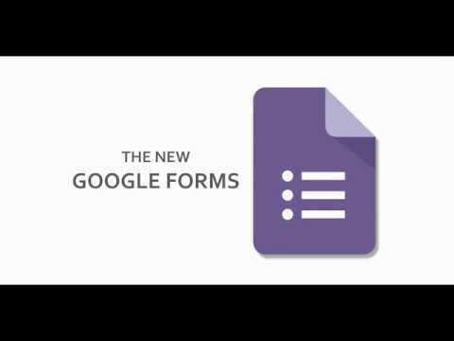
Google Forms
https://youtu.be/uqNHFdZTdvc?list=PLyJP92W0CqyGXMYMSWXw1-s0fRSO7FAxs
1:1 Technology Integration
Notes:
TEACHER’S NOTES:
Show your students the tutorial.
Watch the video closely. After the video, I'll present you with a Google Forms Challenge to complete.

Slide 39
Google Forms Challenge
Create a new Form and name it.
Select a color or image for your Form.
Add your first question (Name) to your form and select “Short answer” as your question type.
Add your second question (What is your favorite color?) to your form and select “Dropdown” as your question type. Add the following options to the question: red, orange, yellow, green, blue, purple, black, and white
Preview your Form.
1:1 Technology Integration
Notes:
TEACHER’S NOTES:
Walk through the challenge with your students.

Slide 40
Google Slides
Google’s version of PowerPoint
Allows collaboration in real time
Can be downloaded as a PowerPoint document
Can upload and convert PowerPoint documents to Slides
1:1 Technology Integration
Notes:
TEACHER’S NOTES:
Slides can be used to make beautiful presentations, e-books, portfolios, and more.

Slide 41
Google Slides
https://youtu.be/zgb5zZJQpaA?list=PLyJP92W0CqyGXMYMSWXw1-s0fRSO7FAxs
1:1 Technology Integration
Notes:
TEACHER’S NOTES:
Show your students the tutorial.
Watch the video closely. After the video, I'll present you with a Slides Challenge to complete.

Slide 42
Google Slides Challenge
Create a new Slides presentation.
Choose a theme.
Title your first slide with your first name and add an image.
Insert a new slide.
Title your second slide with your last name and add a video.
Insert a third slide and add website link.
Apply one type of animation to all the slides in your presentation.
1:1 Technology Integration
Notes:
TEACHER’S NOTES:
Walk through the challenge with your students.

Slide 43
Google Sheets
Google’s version of excel
Allows collaboration in real time
Can be downloaded as an excel document
Can upload and convert excel documents to Sheets
1:1 Technology Integration
Notes:
TEACHER’S NOTES:
Sheets is very similar to excel, however, like Docs, Forms, and Slides, it allows for collaboration.

Slide 44
Google Sheets
https://youtu.be/QTgvX5MLPC8
1:1 Technology Integration
Notes:
TEACHER’S NOTES:
Show your students the tutorial.
Watch the video closely. After the video, I'll present you with a Sheets Challenge to complete.

Slide 45
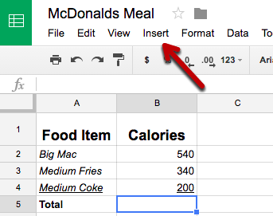
Google Sheets Challenge
Create this table in Sheets – Name it McDonalds Meal.
BOLD the column titles, increase the font size, and italicize the row titles.
BONUS CHALLENGE: Calculate the total calories by highlighting cell B:5, then click insert, function, SUM and select cells B:2, B:3, and B:4, then press enter.
1:1 Technology Integration
Notes:
TEACHER’S NOTES:
Walk through the challenge with your students.

Slide 46
Congratulations!
Your Initial 1:1 Technology Integrations is complete!
Please share your thoughts and questions with me.
Your feedback will help me plan for future trainings.
Notes:
TEACHER’S NOTES:
You may want to prepare a Google Form to collect specific information pertinent to your class. Google Classroom training information appears on the next few slides, however, you may deliver the training as your students are ready.

Slide 47
Google Classroom
Provides organization
Works with the other GAFE
Enhances communication
Requires less time and paper
Easy to setup
1:1 Technology Integration
Notes:
TEACHER’S NOTES:
Google Classroom provides an online platform to keep our digitized classroom organized.
It works with the other Google Apps for Education.
It enhances communication because all communicating is done right from the Google Classroom. Assignment, Posts, and questions seamlessly show up in the Google Classroom stream.
Less time and paper are required because copies of assignments are pushed to you with the touch of a button and paper isn’t needed. You can turn in assignments through Google Classroom.
Today I'll be helping you to add yourself to our classroom with a unique code.

Slide 48
Google Classroom
1:1 Technology Integration
Notes:
TEACHER’S NOTES:
Show your students the introduction video.
Watch the video closely. After the video, we'll get started in Google Classroom.

Slide 49
Google Classroom Challenge
Open Google Classroom.
Click on the Stream tab and find the question I have assigned.
Answer the question and click Turn In.
Also under the Stream tab, find the assignment I've created and follow the directions. Once the assignment is complete, click Turn In.
1:1 Technology Integration
Notes:
TEACHER’S NOTES:
Walk through the challenge with your students.

